Slide 1
HEAP
(Priority Queue)

Slide 2
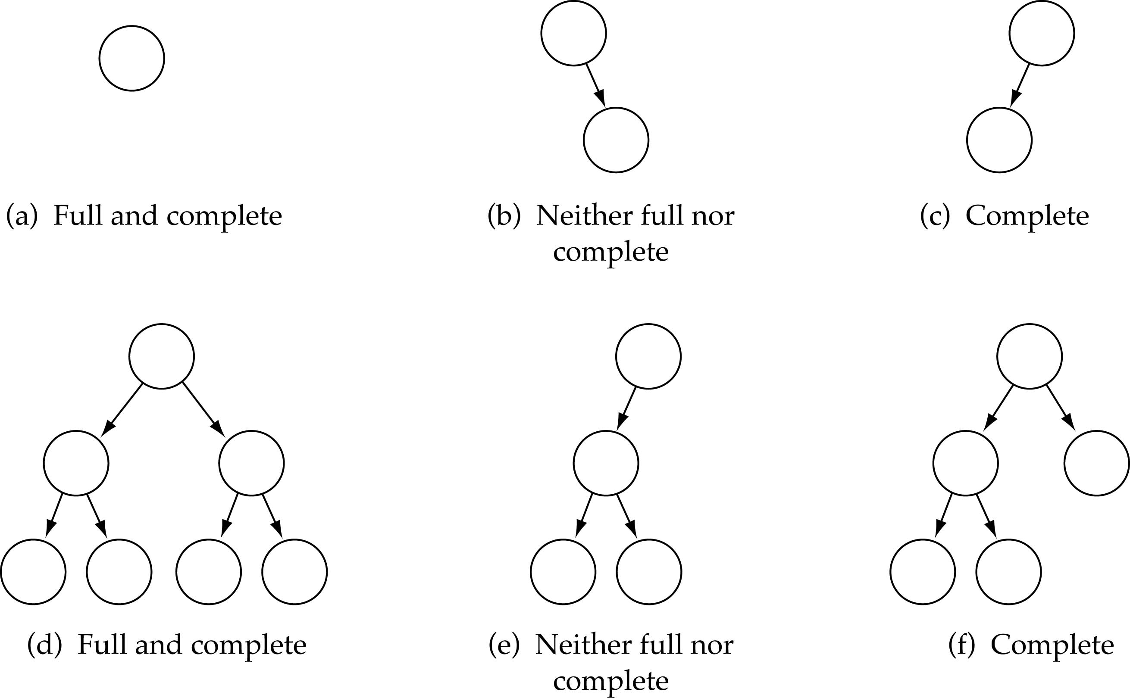
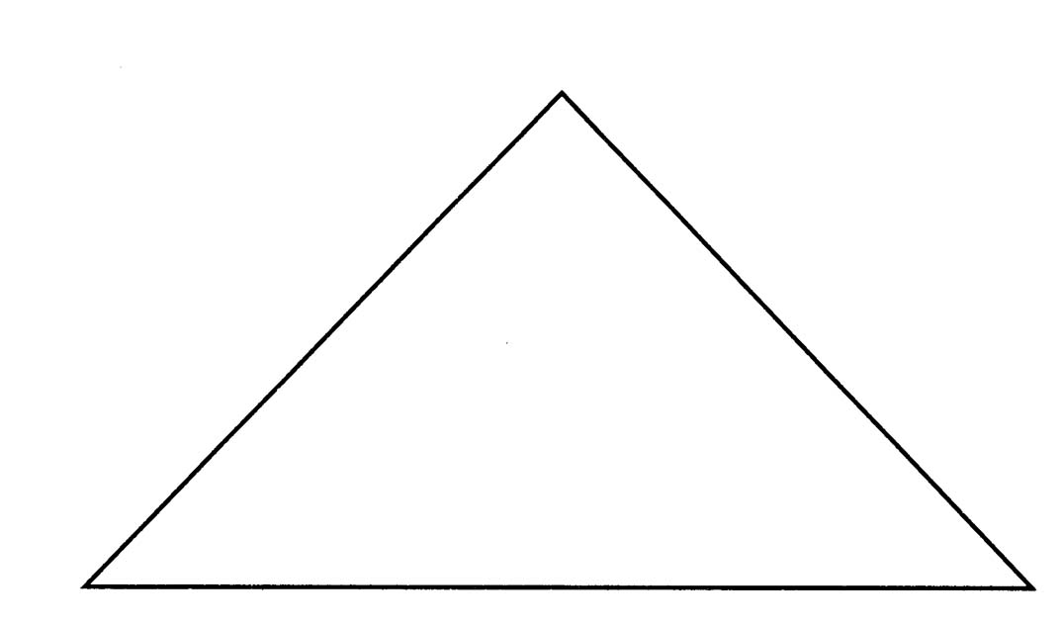
Full Binary Tree
Every non-leaf node has two children
Leaves are on the same level
Full Binary Tree

Slide 3
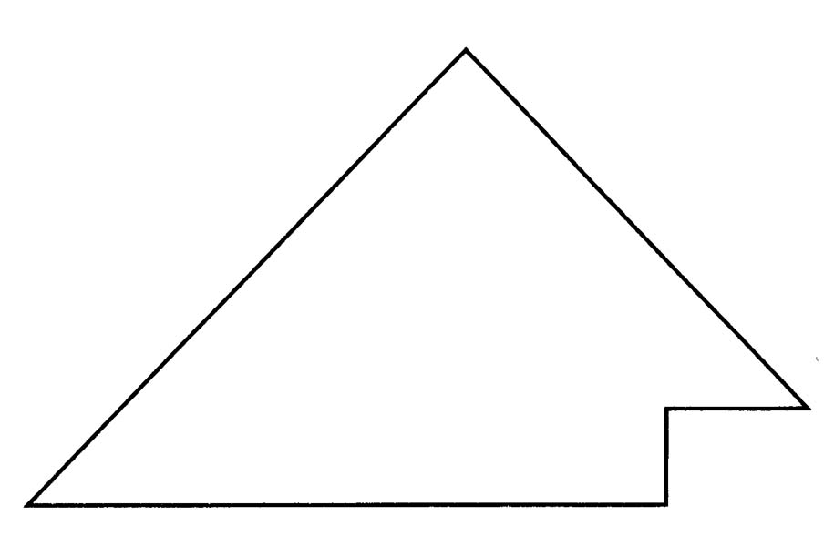
Complete Binary Tree
(1) A binary tree that is either full or full upto the next-to-last level
(2) The last level is full from left to right (i.e., leaves are as far to the left as possible)

Slide 4
What is a Heap (Max)?
It is a binary tree with the following properties:
  Property 1: (Structure) - It is a complete binary tree
  Property 2: (Order) - The value stored at a node is greater ( smaller if Min Heap) or equal to the values stored at the children

Slide 5
Priority Queues
(Another Name for Heap !!)
What is a Priority Queue?
  It is a queue with each element being associated with a "priority"
  From the elements in the queue, the one with the highest priority is dequeued first

Slide 6
Priority Queues
Supports the following operations.
  Insert element x.
  Return min element.
  Return and delete minimum element.
Applications.
  Dijkstra's shortest path algorithm.
  Prim's MST algorithm.
  Heapsort.
Notes:
Event driven simulation: generate random inter-arrival times between customers, generate random processing times per customer, Advance clock to next event, skipping intervening ticks

Slide 7
Heap
A max tree is a tree in which the key value in
each node is no smaller than the key values in
its children. A max heap is a complete binary
tree that is also a max tree.
A min tree is a tree in which the key value in
each node is no larger than the key values in
its children. A min heap is a complete binary
tree that is also a min tree.
Operations on heaps
  creation of an empty heap
  insertion of a new element into the heap;
  deletion of the largest element from the heap

Slide 8
[1]
14
[1]
9
[1]
30
[2]
12
[3]
7
[2]
6
[3]
3
[2]
25
[4]
[5]
[6]
[4]
10
8
6
5
Property:
The root of max heap (min heap) contains
the largest (smallest).

Slide 9
[1]
2
[1]
10
[1]
11
[2]
7
[3]
4
[2]
20
[3]
83
[2]
21
[4]
[5]
[6]
[4]
10
8
6
50

Slide 10
ADT for Max Heap
structure MaxHeap
objects: a complete binary tree of n > 0 elements organized so that
the value in each node is at least as large as those in its children
functions:
for all heap belong to MaxHeap, item belong to Element, n,
max_size belong to integer
MaxHeap Create(max_size)::= create an empty heap that can
hold a maximum of max_size elements
Boolean HeapFull(heap, n)::= if (n==max_size) return TRUE
else return FALSE
MaxHeap Insert(heap, item, n)::= if (!HeapFull(heap,n)) insert
item into heap and return the resulting heap
else return error
Boolean HeapEmpty(heap, n)::= if (n>0) return FALSE
else return TRUE
Element Delete(heap,n)::= if (!HeapEmpty(heap,n)) return one
instance of the largest element in the heap
and remove it from the heap
else return error

Slide 11
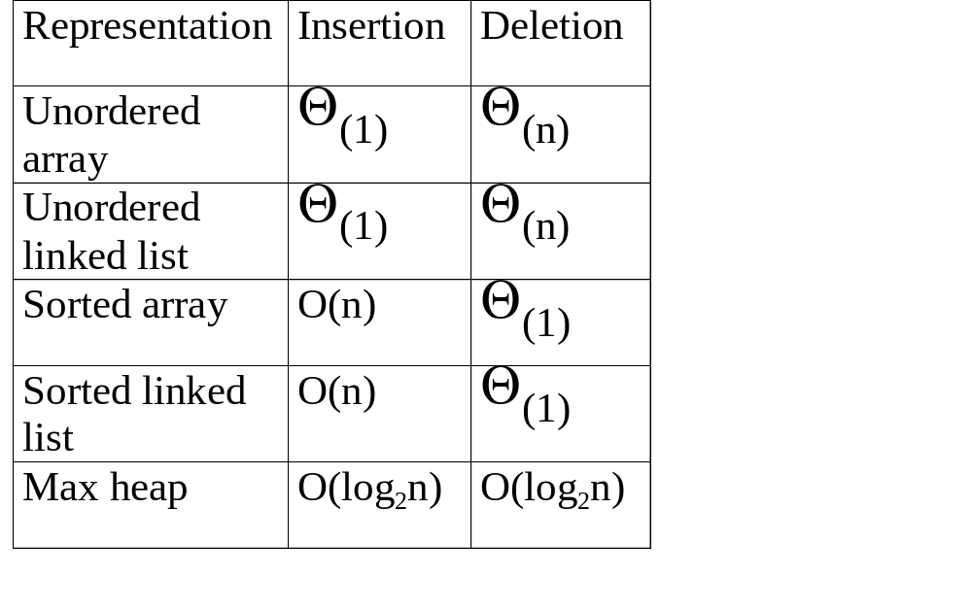

Slide 12
  Binary Heap Array Implementation
  Use an array: no need for explicit parent or child pointers.
    Parent(i) = Floor( i / 2)
    Left(i) = 2i
    Right(i) = 2i + 1

Slide 13
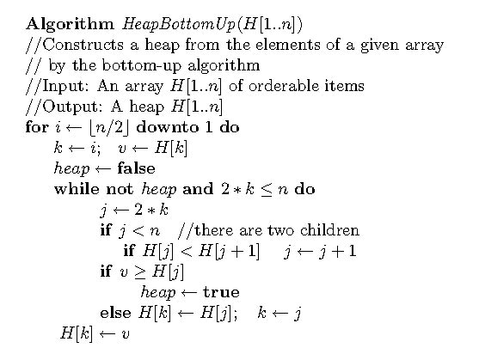
Pseudocode of bottom-up heap construction

Slide 14
Example of Insertion to Max Heap
20
20
21
15
2
15
5
15
20
14
10
14
10
2
14
10
2
initial location of new node
insert 5 into heap
insert 21 into heap

Slide 15
Insertion into a Max Heap
void insert_max_heap(element item, int *n)
{
int i;
if (HEAP_FULL(*n)) {
fprintf(stderr, “the heap is full.\n”);
exit(1);
}
i = ++(*n);
while ((i!=1)&&(item.key>heap[i/2].key)) {
heap[i] = heap[i/2];
i /= 2;
}
heap[i]= item;
}
2^{k}-1=n ==> k=⎡log₂(n+1)⎤
O(log₂n)

Slide 16
Example of Deletion from Max Heap
remove
20
10
15
15
2
15
2
14
2
14
10
14
10

Slide 17
Deletion from a Max Heap
element delete_max_heap(int *n)
{
int parent, child;
element item, temp;
if (HEAP_EMPTY(*n)) {
fprintf(stderr, “The heap is empty\n”);
exit(1);
}
/* save value of the element with the
highest key */
item = heap[1];
/* use last element in heap to adjust heap */
temp = heap[(*n)--];
parent = 1;
child = 2;

Slide 18
while (child <= *n) {
/* find the larger child of the current
parent */
if ((child < *n)&&
(heap[child].key<heap[child+1].key))
child++;
if (temp.key >= heap[child].key) break;
/* move to the next lower level */
heap[parent] = heap[child];
child *= 2;
}
heap[parent] = temp;
return item;
}

